Slide 1
WE.ARE.VR
Virtual Reality Platform
Group #3
Team 3

Slide 2
Summary
Our goal with this project is to provide an interactive way for people to experience unique live events without having to be physically present.
Our idea was to create a platform where musicians, curators of art galleries, or any other event organisers could provide their interested audience with a chance to view their content using virtual reality technology.
Our incentive for our content providers would be advertisement for their events and the sale of virtual reality experiences.

Slide 3
Our Design Problem
Create a platform that allows people to experience live events without being physically present
Create a visually appealing design
Avoid cluttering information and prioritize elegance and simplicity
Create a design that is easy to use with little to no learning curve
Similar to popular mobile media/streaming applications

Slide 4
Interviews and Secondary Research
Our Findings:
Potential end users would be interested in paying a reduced price to see some of their favourite musicians and festivals through VR
They would also be interested in a “trailer” feature for events
There would need to be some financial implication for musicians to even consider our platform
VR technology has become more advanced. The quality, quantity, and ease-of-use has grown steadily over recent years.
Health risks of prolonged VR use (nausea, dizziness, loss of spatial awareness)

Slide 5
Our Design Decisions
Does:
Follow the conventions of popular mobile streaming applications
Simple navigation system
Efficient use of space
Cohesive theme
Donts:
Cluttered information
Ambiguous buttons and icons
Accidental clicks (include prompts for important tasks)
General inconsistencies in our design

Slide 6
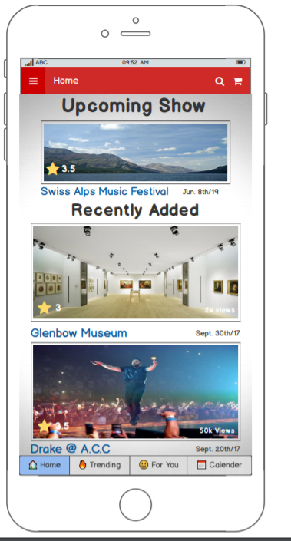
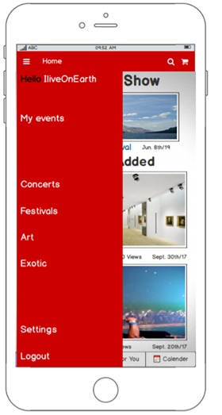
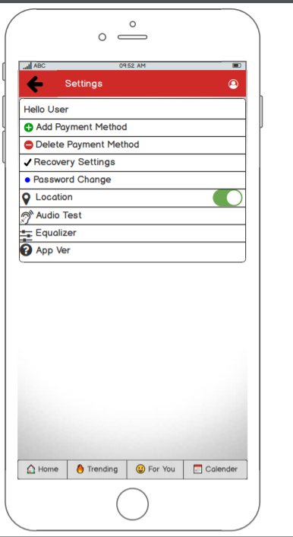
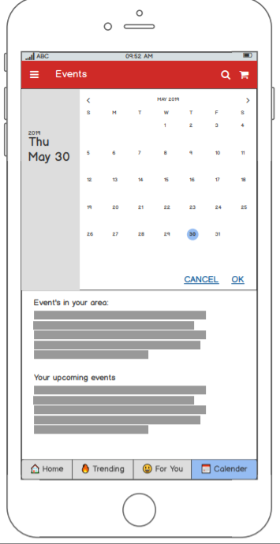
Low Fidelity

Slide 7
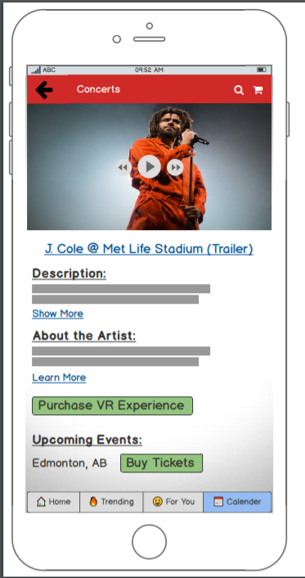
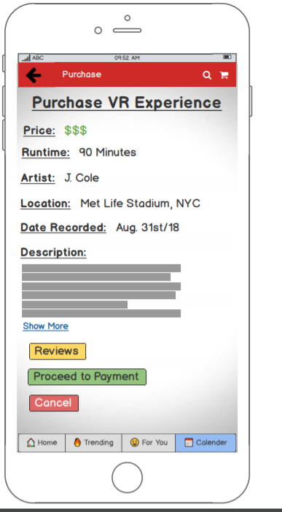
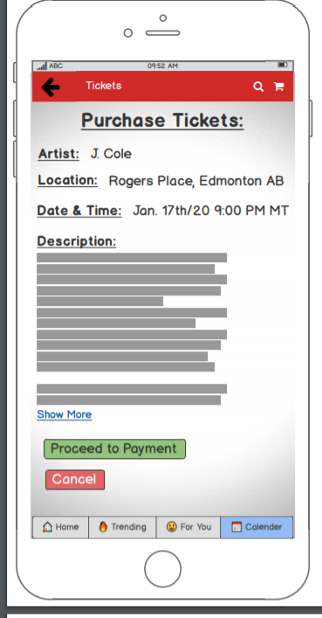
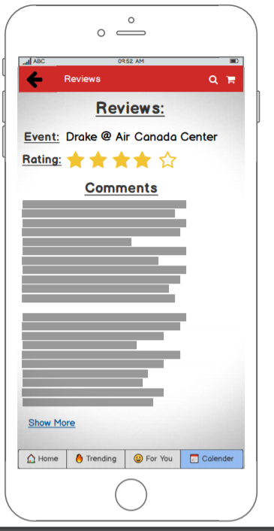
Low Fidelity

Slide 8
High Fidelity
Walkthrough

Slide 9
Heuristic Evaluation
Pros:
Appealing Design
Navigation and overall design follows conventions of other mobile apps
Easily recognizable icons and buttons
Confirmation of decisions
Cons:
Navigation bar overridden by background content
Small inconsistencies in navigation bar across different screens
Pricing was shown to late or not shown at all
Calendar bugs

Slide 10
User Testing
Pros:
Familiar and easy to use
Clean design and easy navigation
Cons:
Calendar functionality
Design of settings pages
Additional Features:
Content creator profiles
Follow creators and receive notifications
News page

Slide 11
Next Iteration...
Improve calendar functionality
Improve settings pages
Content creator profiles
Subscription/following feature
News page

Slide 12
The End
Thank you for the great semester!!!

